Slide 1

Project QuestQ
Simulating the queue of a typical hawker store
40.015: Simulations Modeling and Analysis
Team 3: Bharat Desai (1002098) & Justinian Siah (1001573)
Notes:
Hi Profs I am Justinian and this is Bharat and we will be presenting our project: QuestQ
Where we try to simulate the queueing model of a typical hawker store

Slide 2

Notes:
Now we’ve all been in queues before. At there are times where we are like this guy (click)
Wondering why its taking so long to get to your turn
Well this is our motivation behind our project!

Slide 3
Motivation
Traditional FCFS systems sometimes results in large queue lengths and long queue times
Frustrating for both the customers and store owners
Many establishment shifting to alternative queuing systems (Tandem queue)
Project Statement
Through this project we hope to find out if this alternative queuing system is indeed effective in reducing the time customer spends in the system or is this a perceived effect on the customers' end.
Notes:
Traditionally, stores use a First come first serve system which sometimes result in large queue lengths and long times.
This can be frustrating for both the customers who have to wait longer and puts stress on the owners to process faster
As a result many stores have started to use alternative systems such as the tandem queue where customers are split into two queues ( more on that later) and to great effect.
Our project hopes to find out if this alternative is indeed better in reducing the time customers spend in the system or is this just a perceived effect

Slide 4
Motivation
Traditional FCFS systems sometimes results in large queue lengths and long queue times
Frustrating for both the customers and store owners
Many establishment shifting to alternative queuing systems (Tandem queue)
Project Statement
Through this project we hope to find out if this alternative queuing system is indeed effective in reducing wait times or is this a perceived effect on the customers' end.
Notes:
Traditionally queues in food and beverage outlets, and queues in Singaporean food courts and hawker centres have followed a First-come-First-serve systems, in order to deliver the product first to customers who made the order first. Sometimes results in large queue lengths and long queue times if the service rate of the store is unable to match the arrival rate of customers.
Frustrating for both the customers, who need to deal with the time they spend queuing, as well as the store owners, who are pressured to serve the growing queue. In recent times, there have been an increasing number of shops and stores opting for alternative queueing systems, most notably the split queue system. The first queue follows the traditional FCFS queue, where customers queue to place their order and payment. Afterwards, customers proceed to wait for their food/items in the second queue. Orders may not be served in the sequence they were made. This allows shopkeepers to reduce production time by preparing similar dishes together as they have more knowledge about what the incoming orders are.
Through this project we hope to find out if this alternative queuing system is indeed effective in reducing wait times or is this a perceived effect on the customers' end.

Slide 5
Project Description
Model and simulate the queueing systems of a food stalls in the SUTD canteen during peak periods, including arrivals and service.
By simulating the original customer arrival rate with the new model, we will determine if the alternative queueing model result in shorter time spent in the system by the customer.
Notes:
In this project, we aim to model and simulate the queueing systems of one of the food stalls in the SUTD canteen during peak periods.
By simulating the original customer arrival rate with the new model, we will determine if the alternative queueing model results in a greater throughput rate.

Slide 6
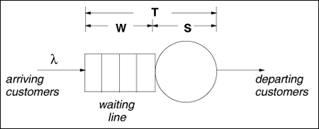
Traditional Queue
Notes:
So the traditional queuing system system utilizes a MM1 system which is first come first serve
Customers arrive at the back of a waiting line and the store owner takes order, collects payment and serves food to the front of the line before moving to the next customer.

Slide 7
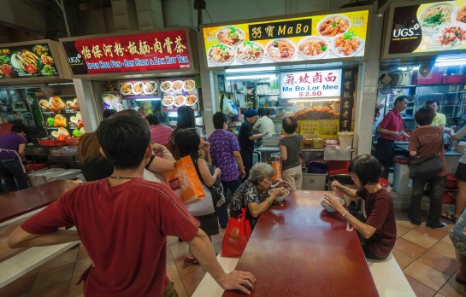
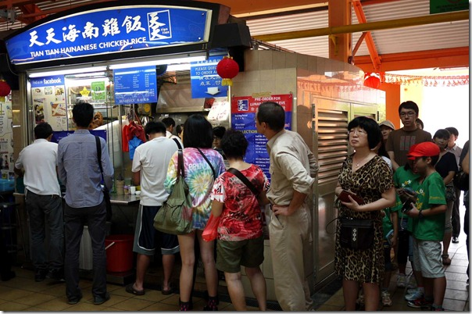
Notes:
Here are some visual examples
Which are your usual hawker stores.

Slide 8
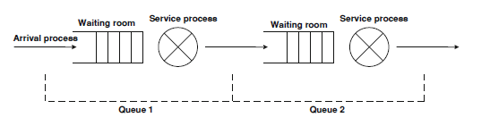
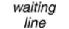
Tandem Queue (Alternative)
Notes:
The alternative method we are considering in this project is the tandem queue.
How it works its that there are two queues.
The first, queue 1 is the same as the previous, here customers place their order and make payment.
Then they leave the first queue1 and enter the second.
The difference is that in the second queue, it is no longer a waiting line but rather a waiting room.
This is because food can be prepared in batches and it is possible for a customer to receive his order before the person in front of him.

Slide 9
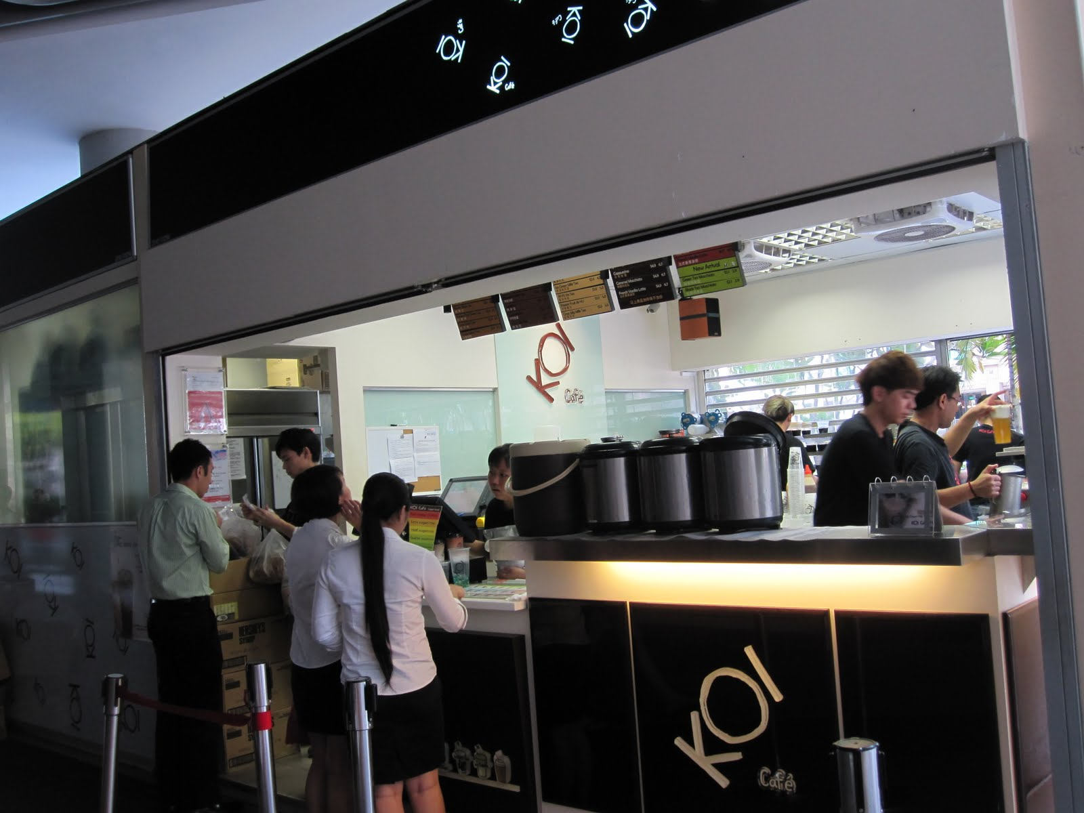
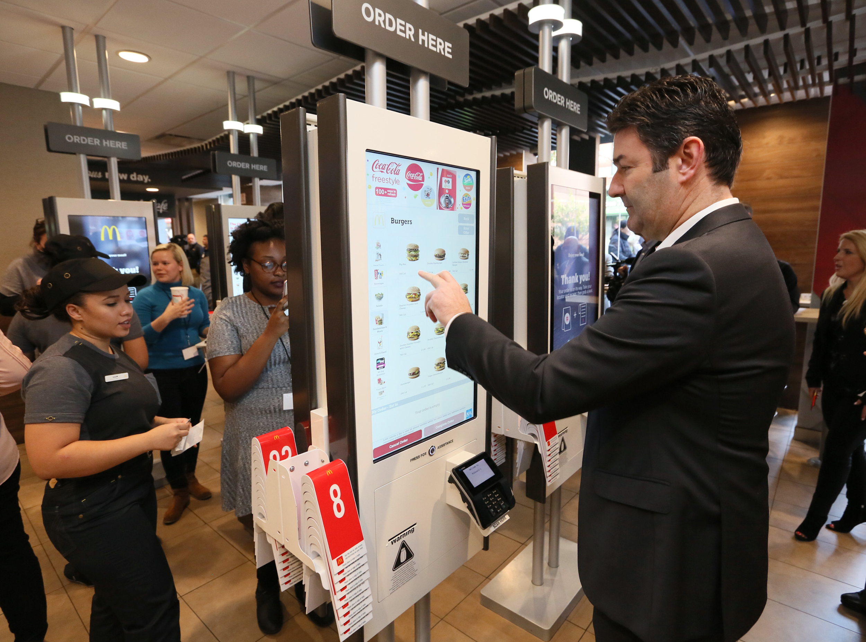
Notes:
Examples of this is the bubble tea koi as well as the new mcdonalds self service counters.
Closer to home, the Korean and Japanese store in the SUTD canteen also follow this model.

Slide 10
Data collection
Notes:
Moving on to our data collection

Slide 11
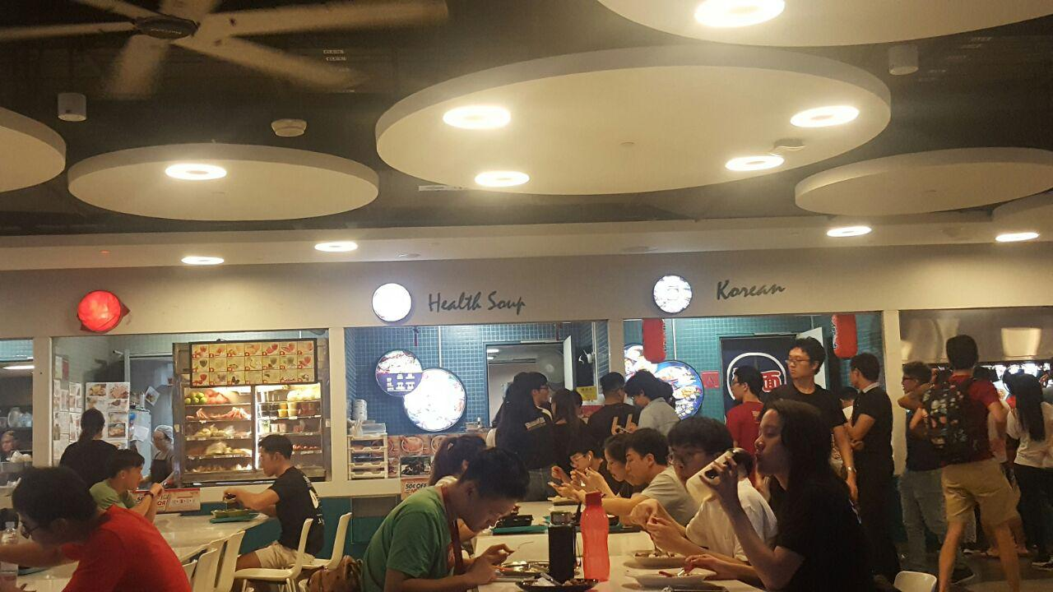
Data Collection
Notes:
Our target store is the Health Soup Store in the canteen, which best emulates the mm1 queue model

Slide 12
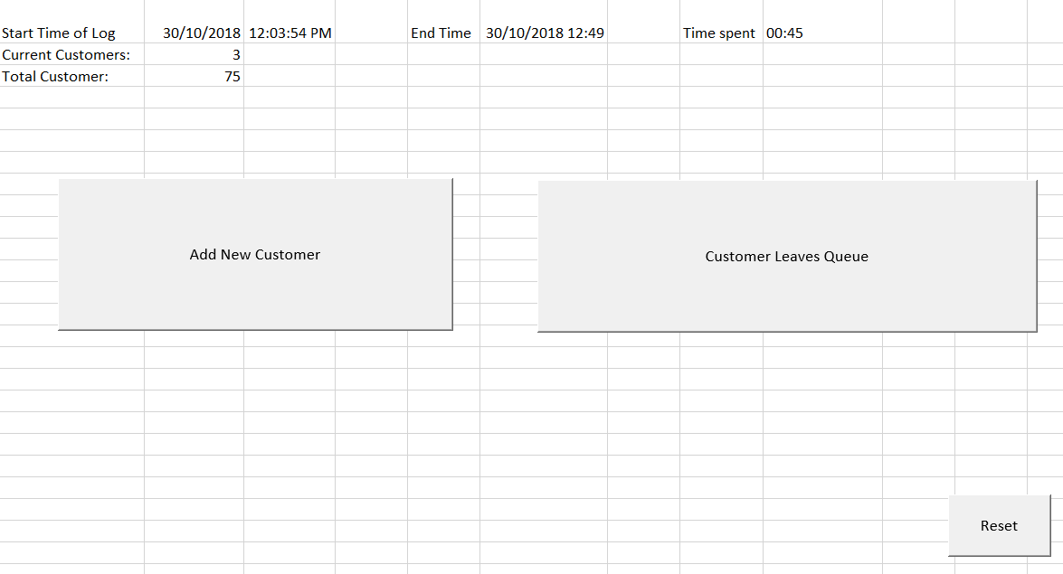
Data Collection
Notes:
We created a interface in VBA excel in order to help us to collect data.
Rather than using a paper and transferring the data later, this app collect information simply by clicking a few buttons.
If we have time at the end, we will demonstrate how this works.

Slide 13
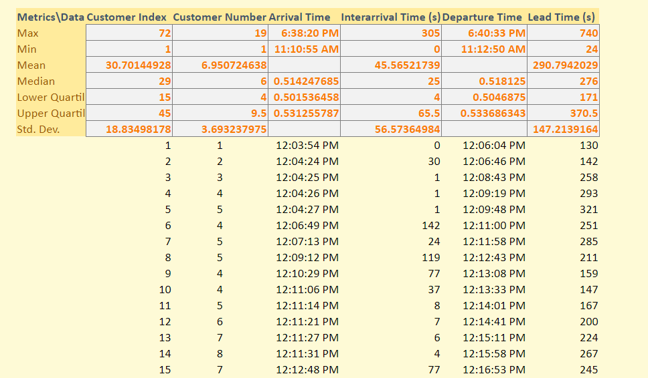
Data Collection
Notes:
Here is the output of the vba app, it collects the time, interarrival times and total time spent in the system automatically.

Slide 14
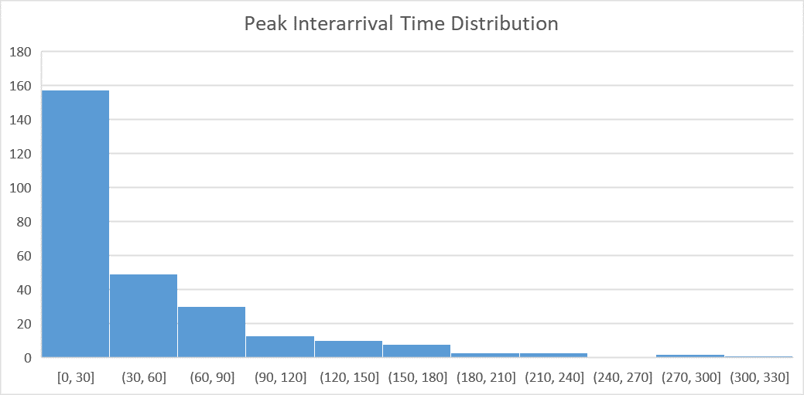
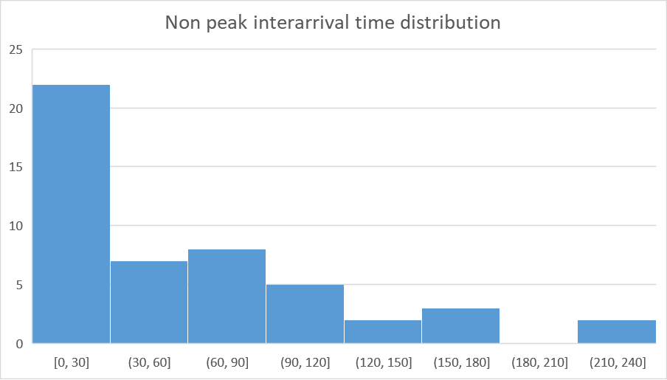
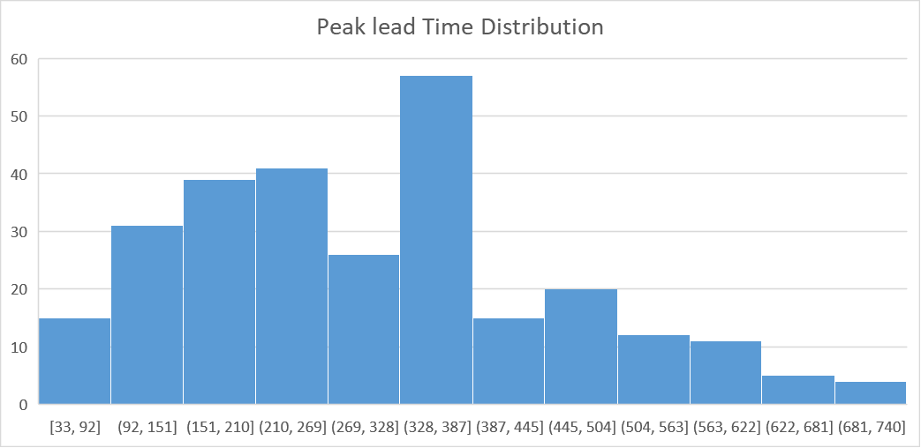
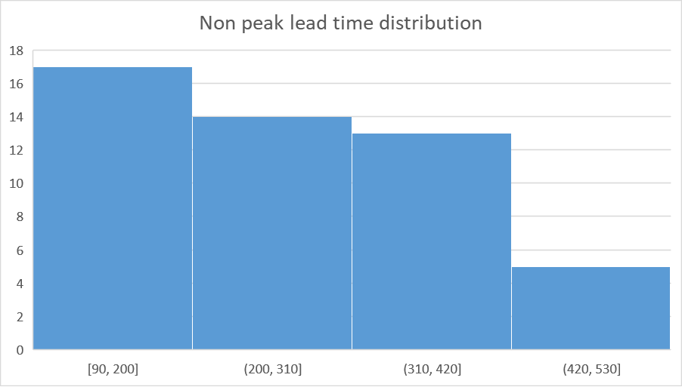
Data Visualization
Peak hour
Non-Peak hour
Notes:
Here is a visualization of the the data collected.
On the left we see the peak hour (1130-1230) interarrival times and lead times
On the right is the non-peak hour (1100-1130)

Slide 15
Simulation
Notes:
In this section, i will be discussing how we designed the queueing systems that were used for comparison.

Slide 16
Decision Rules
1. Customers who join queues always makes an order
2. Service times by cashiers are modeled as fixed values although there is some variation in reality.
3. Assume that various items sold follow a same service rate distribution
4. Assume that cooking operations remain unchanged
5. Batch arrivals need not be accounted for precisely.
Notes:
Before we begin discussion of our simulation models proper, we begin by evaluating some decision rules we made while structuring our project.
1. Customers who join queues always makes an order. In reality, there is a small occurrence of customers that leave queues before making orders. In data collection, these observations are voided, and will not be accounted for. As such, in simulation design the probability distribution of customers leaving prematurely are not modelled.
2. Service times by cashiers are modeled as fixed values although there is some variation in reality especially during non peak hours. However, based on our observations, service times of cashiers during peak hours remain relatively constant.
3. Despite preparation times for different items served by a food stall being different, we assume that various items sold by one stall follow a singular service time distribution for the sake of reducing model complexity.
4. We assume that cooking operations remain unchanged despite modeling the queuing system differently.
5. Lastly, we noticed that several times, customer arrivals came in batches. This is not accounted for very well in our simulated interarrival distribution, and are instead modeled as subsequent inter arrivals that come in and extremely short intervals instead.

Slide 17
Comparing Alternative Queueing Systems (Experimental Design)
Objective / Key Questions
Sensitivity Analysis
Simulation Run Structure
Simulation Run Duration

Slide 18
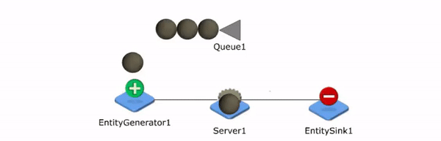
Simulation Visualization
FCFS Queue
Notes:
Typical M/M/1 Qeueue.

Slide 19
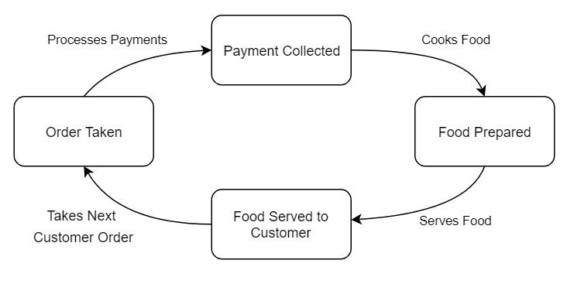
FCFS Simulation Design
Notes:
State change diagram

Slide 20
Parameter Estimation - FCFS Model
Non-Peak Interarrival Time, λ ~ Exp(56)
Peak Interarrival Time. λ ~ Exp(43)
Service Time. µ ~ Norm(40,10)

Slide 21
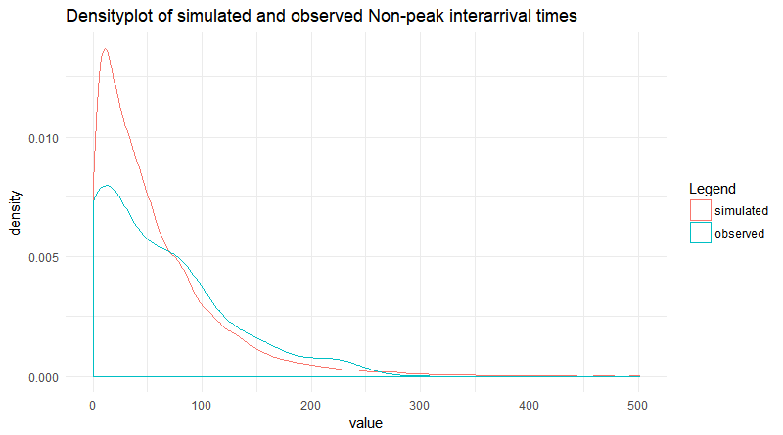
Non-Peak Interarrival Times: Simulated vs Observed
H₀: Mean of simulated and observed inter-arrival observations are statistically equivalent, μ₀ = μ₁
H_{α}: Mean of simulated and observed observations are not statistically equivalent, μ₀ ≠ μ₁
P value of 0.321
At 95% confidence level, H₀ is not rejected.
Notes:
First, we were interested in checking if our simulated distribution models what we observed in reality, so we plotted the density of interarrival times. On the figure here we see that ur simulated model, is slightly left skewed as compared to what is observed, favoring shorter interarrival times. We conducted a paired t-test between simulated and observed values, to validate the null hypothesis that the mean of our simulated and observed values were statistically similar, or equivalent.

Slide 22
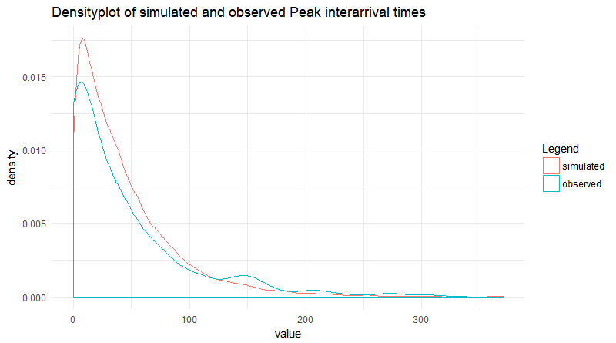
Peak Interarrival Times: Simulated vs Observed
H₀: Mean of simulated and observed inter-arrival observations are statistically equivalent, μ₀ = μ₁
H_{α}: Mean of simulated and observed observations are not statistically equivalent, μ₀ ≠ μ₁
P value of 0.3202!
At 95% confidence level, H₀ is not rejected.
Notes:
*say we did for non-peak as well

Slide 23
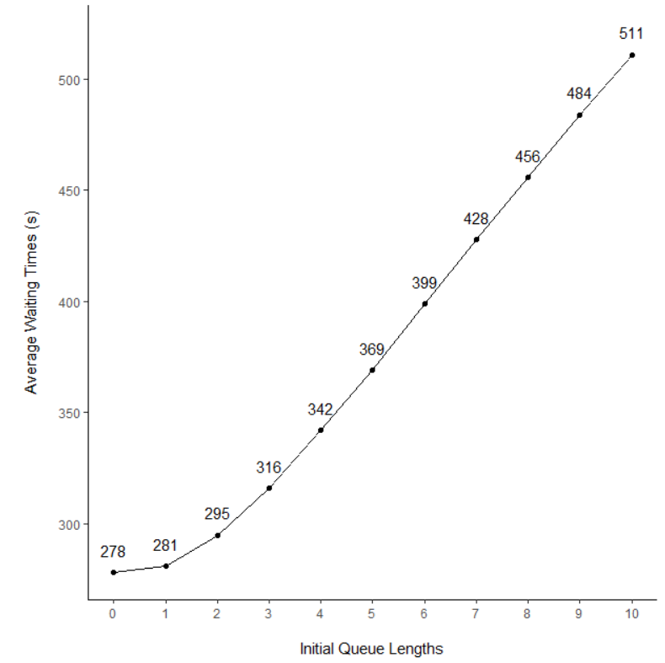
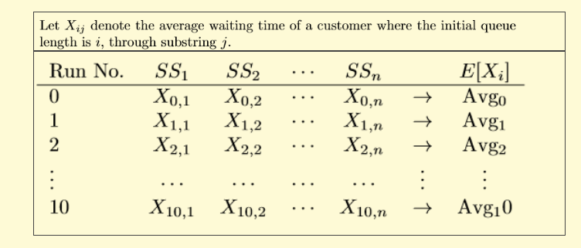
Sensitivity Analysis:
Simulating Different Initialization Queue Lengths
Notes:
Realised that initial queue length affects total time spent in system, so instead of using a mean/random initial queue length

Slide 24
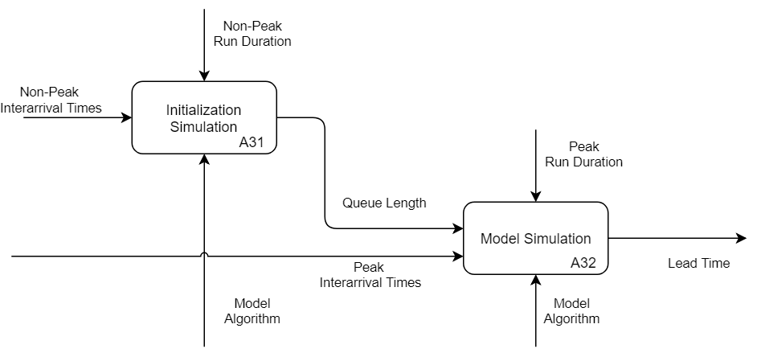
Simulation run structure

Slide 25
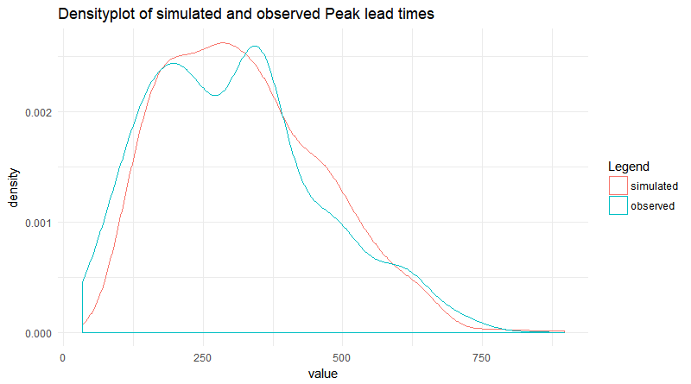
FCFS Lead Times- Simulated vs Observed
H₀: Mean of simulated and observed peak lead time values are statistically equivalent, μ₀ = μ₁
H_{α}: Mean of simulated and observed peak lead time values are not statistically equivalent, μ₀ ≠ μ₁
P-value of 0.0681 !
At 95% confidence level. H₀ is not rejected.

Slide 26
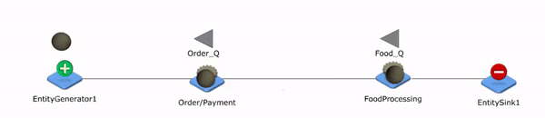
Tandem queue simulation visualization
FCFS
Tandem

Slide 27
Tandem Queue
Notes:
State Diagram

Slide 28
Parameter Estimation - Tandem Model
Non-Peak Interarrival Time, λ ~ Exp(56)
Peak Interarrival Time. λ ~ Exp(43)
Service Time (Order). Fixed (20)
Service Time (Collection). µ ~ Norm(20,10)
Notes:
Next, Justinian will be evaluating the simulation of the tandem model we generated and comparing it with the FCFS model we built earlier on.

Slide 29
Objective:
In which system does the customer spend less time in, during a peak hour period?
How do we show this?
μ_{i} Expected average lead times for one customer in system i, where i ∈ (1, 2).
Identify a confidence interval of ζ = μ₁ - μ₂ at 95% confidence level and see if the interval contains 0 (or lies on one side of it)
Notes:
Right so in order to statistically compare the difference in total time spent in the system
We use the average lead time for a customer in the system as our comparison statistic.
Using common random numbers we repeated the simulation for both queuing models and used a t-test on the difference in expected lead times.
We want to identify a confidence interval of zeta = miu 1 - miu 2 at a 95% confidence level and see if it contains 0 or not

Slide 30
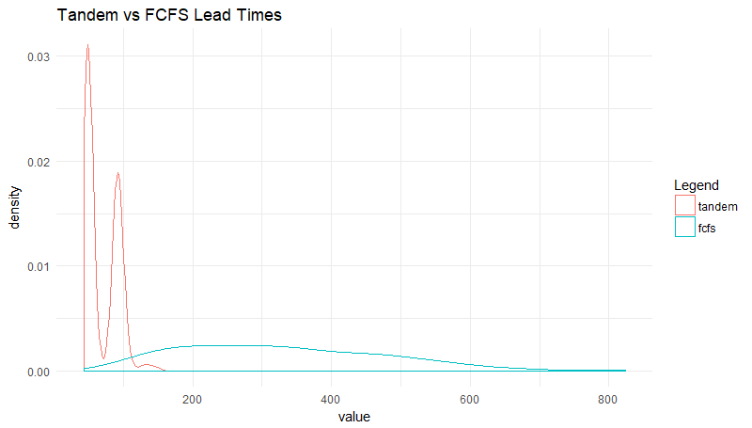
Lead Times- FCFS vs Tandem
H₀: Mean of simulated and observed peak lead time values are statistically equivalent, μ₀ = μ₁
H_{α}: Mean of simulated and observed peak lead time values are not statistically equivalent, μ₀ ≠ μ₁
Notes:
Here is our test hypothesis.
H0 is that the simulated lead times are the same
Ha is that they are not the same.
As seen in the simulated lead times, we expect that the tandem queue will result in a shorter lead time

Slide 31
FCFS vs Tandem
We simulated 100 iterations of the two systems with CRN and took the difference between the average lead time. The resulting confidence interval with α = 0.05:
( 239.5266 , 296.6334 )
Since 0 is not within the confidence interval, we can say with 95% confidence that the true difference will be positive, meaning that the alternative system is preferred as the original system has a higher average waiting time.
Notes:
We simulated 100 iterations of the both queues using common random number form the rstream package and took the difference in the means.
This is the resulting confidence interval.

Slide 32
Limitations of simulation models
No constraints on the maximum number of orders
If a large number of orders were received at once, then our model assumes that all their orders can be processed.
In reality, this assumption works only for F&B Outlets with bigger kitchens.
Unable to observe the rate at which internal kitchen operations were conducted -> Not able to factor these considerations in.
Distribution unable to account for batch arrivals
Friends coming together etc.
Notes:
The biggest limitation to the tandem queueing system model was that there were no constraints placed on the maximum number of orders that could be processed at any particular period. For instance, if a large number of orders were received in a short span of time, then our model assumes that all their orders can be processed.
In reality, this assumption works only for F&B Outlets with bigger kitchens. As we were unable to observe the rate at which internal kitchen operations were conducted, we weren't able to conclusively factor these considerations in.
In conclusion, we are not able to definitely conclude that the tandem queueing system is a better model, although our research indicates a lot of promise that it could be used to improve the waiting experience of customers.

Slide 33
Conclusion
The tandem model is a viable alternative, but more research needs to be done by taking into consideration the internal cooking operations for the store .
Although our research indicates a lot of promise that it could be used to improve the waiting experience of customers. Due the assumptions made in the simulation, we are not able to conclusively say that the tandem queueing system is a significantly better model.

